Slide 1
IOT Base Obstacle Detection

Slide 2
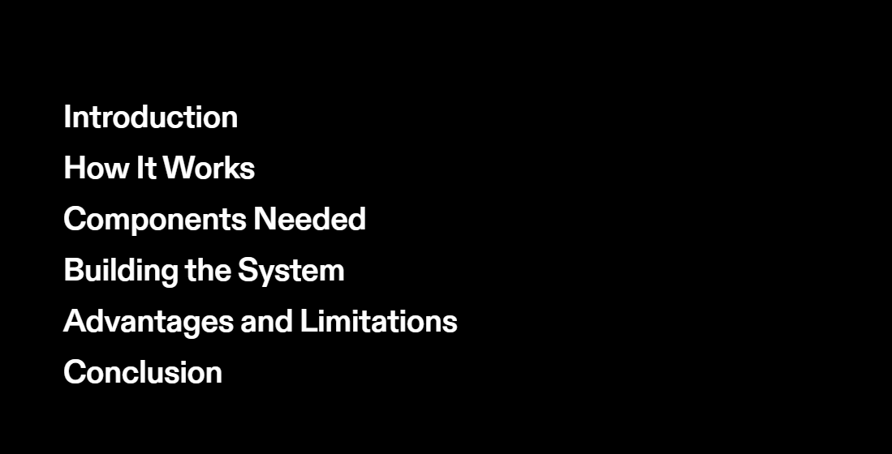

Slide 3


Slide 4
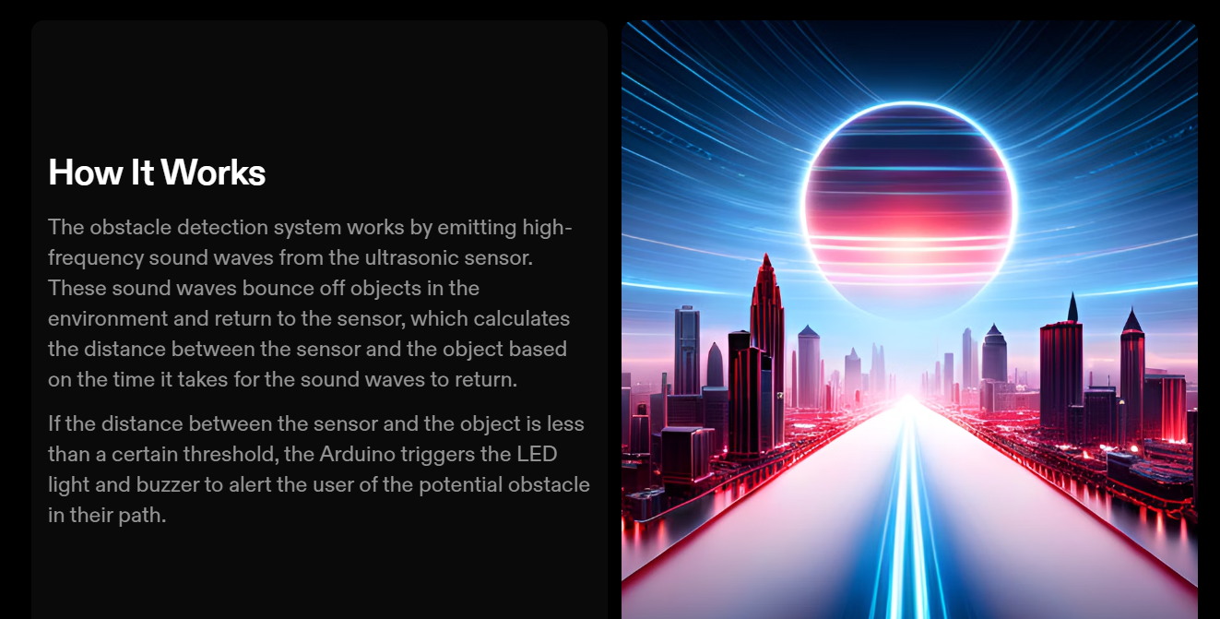

Slide 5
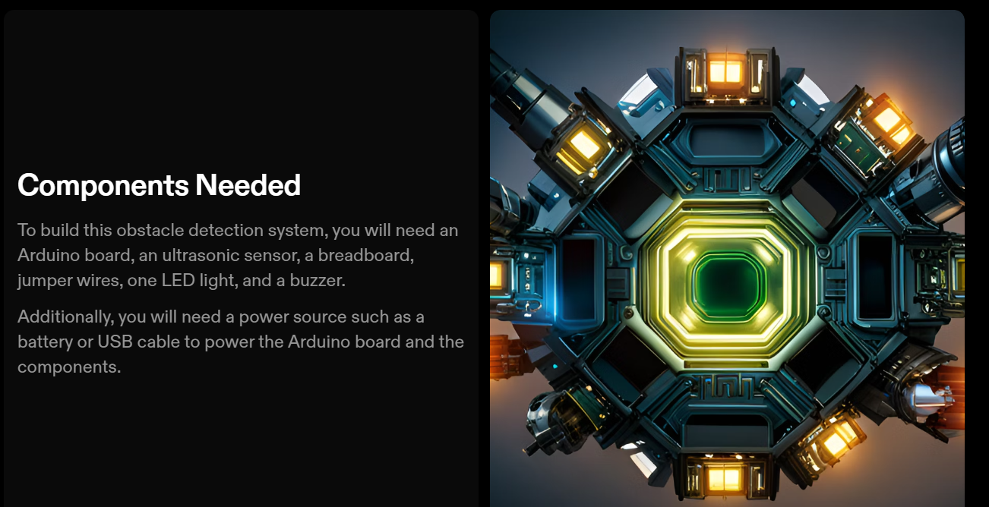

Slide 6


Slide 7
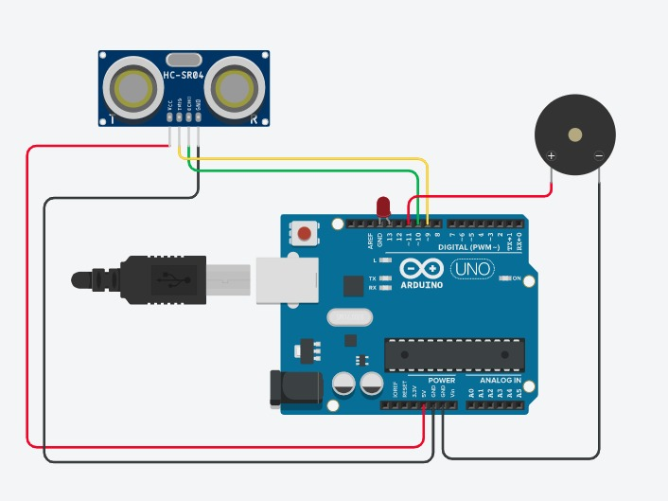
Circuit Diagram

Slide 8
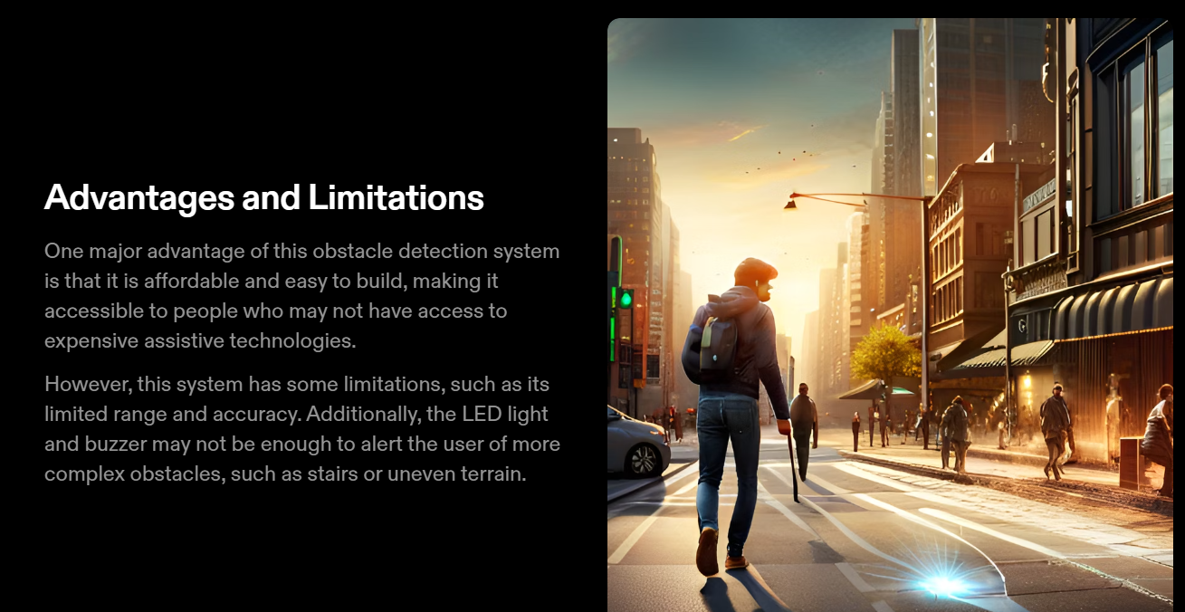

Slide 9


Slide 10
Thank You…

